Slide 1
Unit 6
DATA PERSISTENCE

Slide 2
Introduction
For Android, there are primarily three basic ways of handling persisting data:
A lightweight mechanism known as shared preferences to save small chunks of data.
Traditional file systems.
A relational database management system through the support of SQLite databases.

Slide 3
There are several options for saving this type of preference:
Save Data to a File
To save the data to a file, an individual has to perform some file management routines, such as writing the data to the file, indicating how many characters to read from it, and so on.
Also, if one has Several pieces of information to save, such as text size, font name, preferred background color, and so on, then the task of writing to a file becomes more onerous.
Writing Text to a Database
An alternative to writing to a text file is to use a database.
However, saving simple data to a database is overkill, both from a developer’s point of view and in terms of the application’s run-time performance.
Using SharedPreferences Object
Android provides sharedpreferences object to help you use simple application data .
Android shared preferences are used to store the data in key and value pair so that we can retrieve the values on basis of keys .

Slide 4
Saving & Loading User Preferences
Android provides the SharedPreferences object to help you save simple application data.
For example, your application may have an option that enables users to specify the font size used in your application. In this case, your application needs to remember the size set by the user so that the size is set appropriately each time the app is opened.
SharedPreference gives you the best way to save small data without using a database and it keeps the data on the users device as long as the device app does not clear the data or unistall the app, till then the user preferences remain on the app.

Slide 5
Persisting data to files
The SharedPreferences object enables you to store data that is best stored as name/value pairs—
for example, user ID, birth date, gender, driver’s license number, and so on.
However, sometimes we might prefer to use the traditional file system to store your data.
For example, you might want to store the text of poems you want to display in your applications.
In Android, you can use the classes in the java.io package to do so.

Slide 6
Persisting data to files
Internal Storage in Android
The stored data in memory is allowed to read and write files. When files are stored in internal storage these file can only be accessed by the application itself not by other applications. These files in storage exist till the application stays over the device, as you uninstall the application, the associated files get removed automatically. The files are stored in directory data/data which is followed by the application package name. User can explicitly grant the permission to other apps to access files. Technique is best suited when data can only be access by the application neither by the user nor by other apps.
External Storage in Android
The data is stored in a file specified by the user itself and user can access these file. These files are only accessible till the application exits or you have SD card mounted on your device.
Important Note: It is necessary to add external storage , the permission to read and write. For that you need to add permission in android Manifest file.
<uses-permission android:name="android.permission.WRITE_EXTERNAL_STORAGE" />
<uses-permission android:name="android.permission.READ_EXTERNAL_STORAGE" />

Slide 7
Choosing the Best Storage Option
The previous sections described three main ways to save data in your Android applications: the SharedPreferences object, internal storage, and external storage. Which one should you use in your applications? Here are some guidelines:
If you have data that can be represented using name/value pairs, then use the SharedPreferences object. For example, if you want to store user preference data such as username, background color, date of birth, or last login date, then the SharedPreferences object is the ideal way to store this data.
Moreover, you don't really have to do much to store data this way. Simply use the SharedPreferences object to store and retrieve it.
If you need to store ad-hoc data then using the internal storage is a good option.
For -example, your application might need to download images from the web for display. In this scenario, saving the images to internal storage is a good solution.
OR You might also need to persist data created by the user, such as when you have an application that enables users to take notes and save them for later use. In both of these scenarios, using the internal storage is a good choice.
There are times when you need to share your application data with other users. For example, you might create an Android application that logs the coordinates of the locations that a user has been to, and subsequently, you want to share all this data with other users. In this scenario, you can store your files on the SD card of the device so that users can easily transfer the data to other devices (and computers) for use later.

Slide 8
SQLite
SQLite is a freely available open source database provided in Android. SQLite is a lightweight and compact database that does not require any kind of server to run. It is easily integrated into any kind of mobile application. There are many libraries and classes available on Android to perform any kind of database queue on SQLite. It provides so many commands like add new data, update, read, and delete data.
Android has built in SQLite database implementation.
For saving relational data, using a database is much more efficient. Moreover, using databases enables you to enforce data integrity by specifying the relationships between different sets of data.Android uses the SQLite database system.
The database that you create for an application is only accessible to itself; other applications will not be able to access it.
Android provides different ways to store data locally , so using SQLite is one of the way to store data. SQLite is a structured query based database, hence we can say it’s a relational database. Android Operating System has its own implementation to perform CRUD (Create, Read, Update, Delete)operations, so Android provides set of classes available in android.database and android.database.sqlite packages.

Slide 9
SQLiteOpenHelper class
SQLiteOpenHelper class
SQLiteOpenHelper is an abstract class with two abstract methods
1.onCreate(SQLiteDatabase db) - Called when the database is created for the first time.
2.onUpgrade(SQLiteDatabase db, int oldVersion, int newVersion) -is only called whenever there is a updation in existing version so to update a version we have to increment the value of version variable passed in the superclass constructor.
.
.

Slide 10
SQLiteOpenHelper class
SQLiteOpenHelper Class:
We can use this class for creating a database and also we can use it for version management. This class provides the onCreate() and onUpgrade() methods for performing any database operation.
Constructors of SQLiteOpenHelper Class:-
SQLiteOpenHelper class has two constructors.
SQLiteOpenHelper(Context context, String name, SQLiteDatabase.CursorFactory factory, int version): This constructor creates an object for creating, opening, and managing the database.
SQLiteOpenHelper(Context context, String name,SQLiteDatabase.CursorFactory factory, int version,DatabaseErrorHandler errorHandler): This constructor creates an object for creating, opening, and managing the database. It specifies the error handler.
Methods of SQLiteOpenHelper class:
SQLiteOpenHelper class has many methods. Some of them are as follows:
public abstract void onCreate(SQLiteDatabase db): This method is called only when you create a database for the first time.
public abstract void onUpgrade(SQLiteDatabase db, int oldVersion, int newVersion): This method is called when the database needs to be upgraded.
public synchronized void close(): This method closes the database object.

Slide 11
SQLiteOpenHelper class
SQLite database class:
We have different methods in this class which are used to perform some commands on SQLite databases such as create, update, delete, select, etc.
Methods of SQLiteDatabase class:
SQLite database class has many methods. Some of them are as follows:
void execSQL(String sql): This method executes a SQL query that is NOT a SELECT query.
long insert(String table, String nullColumnHack, ContentValues values): This method inserts a record on the database.
int update(String table,ContentValues values,String whereClause, String[]whereArgs): This method is used for updating a row.

Slide 12
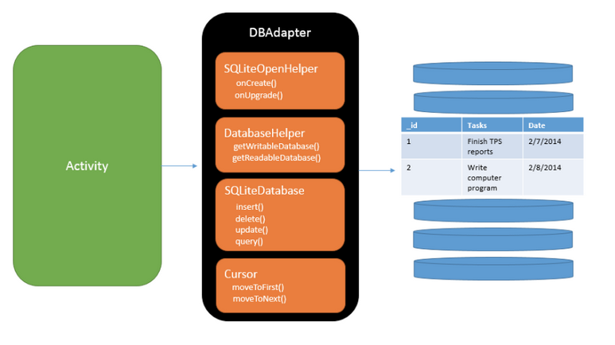
Overview of SQLite Database
.

Slide 13
Thank You

